Slide 1
Applies Data Structure and Application
Dr Sachin K Saxena Sr Data Analyst, Portugal, MNC
Ex-Sr Software Engineer - Data Scientist

Slide 3
Content
Trees: Introduction
Binary Trees and their Representation
Algebraic Expressions
Complete Binary Tree
Extended Binary Trees
Array and Linked Representation of Binary Trees
Traversing Binary Trees

Slide 4
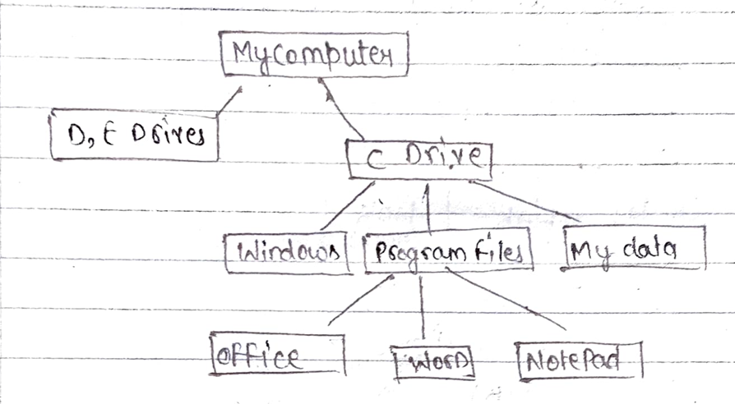
Trees: Introduction
In Computer Science, a tree is a widely used data structure that consisits a set of link node.

Slide 5
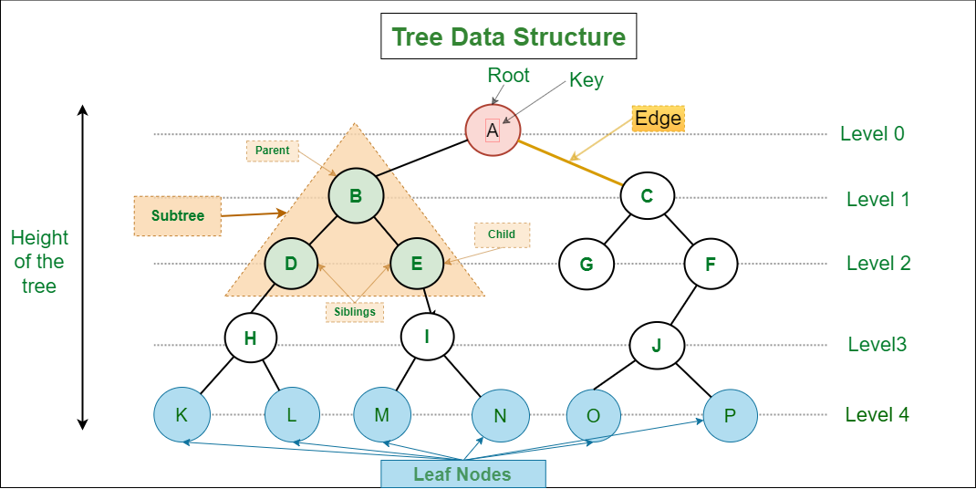
Trees: Introduction

Slide 6
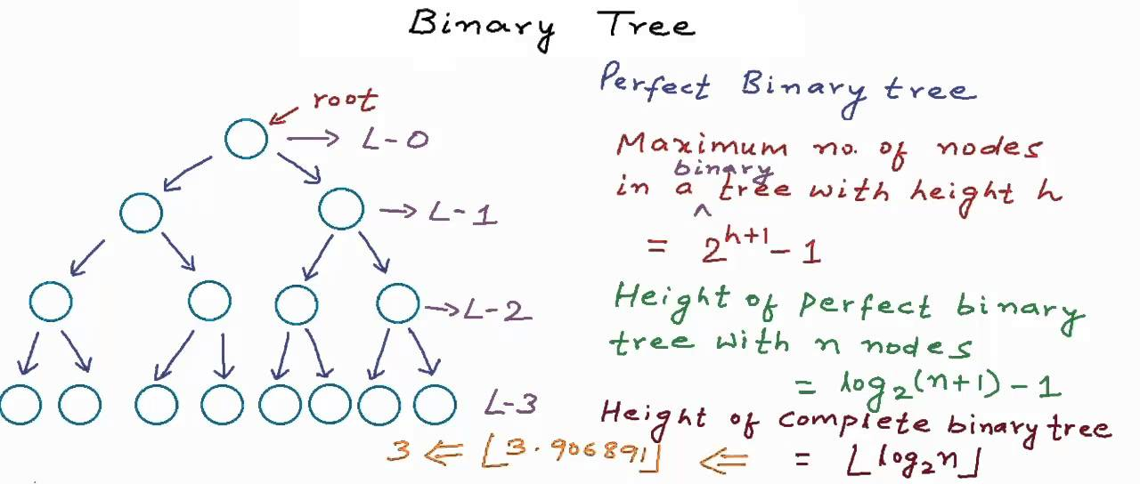
Binary Trees and their Representation
A binary tree is a special form of an m-ary tree where m=2.

Slide 7
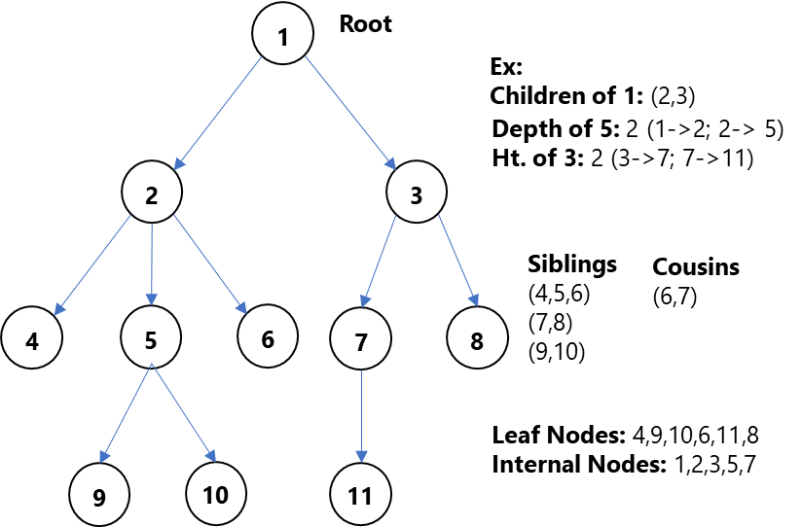
Binary Trees and their Representation

Slide 8
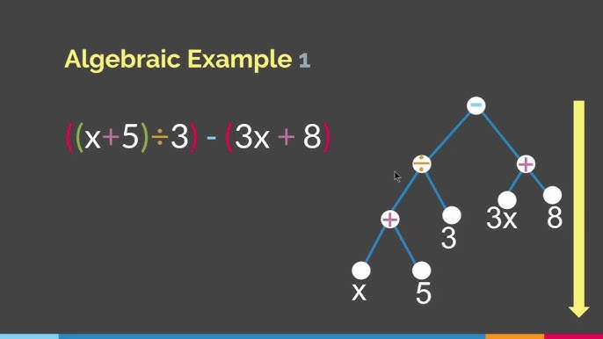
Algebraic Expressions

Slide 9
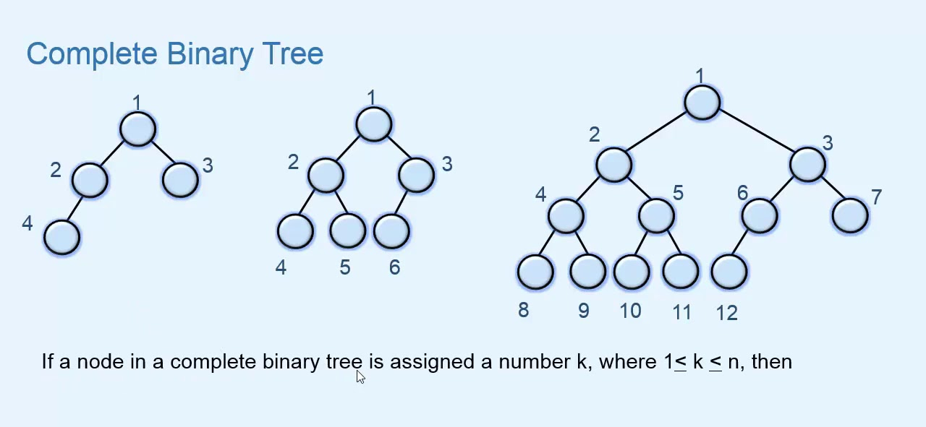
Complete Binary Tree

Slide 10
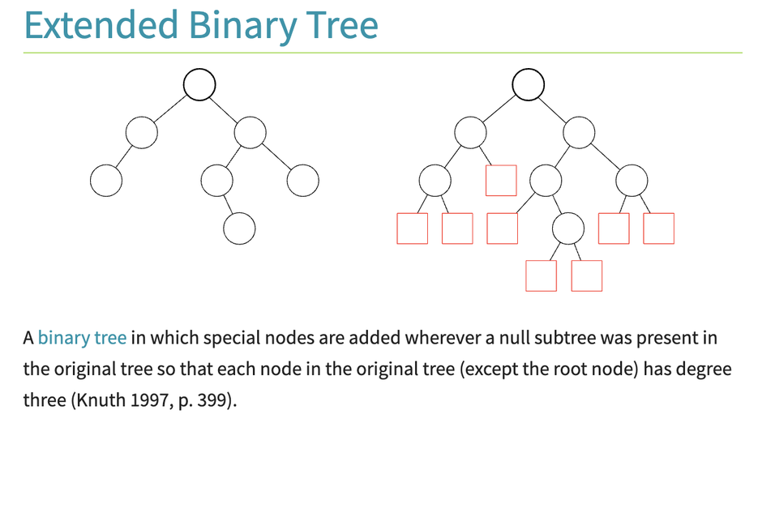
Extended Binary Trees

Slide 11
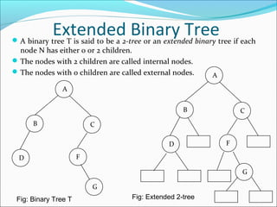
Extended Binary Trees

Slide 12
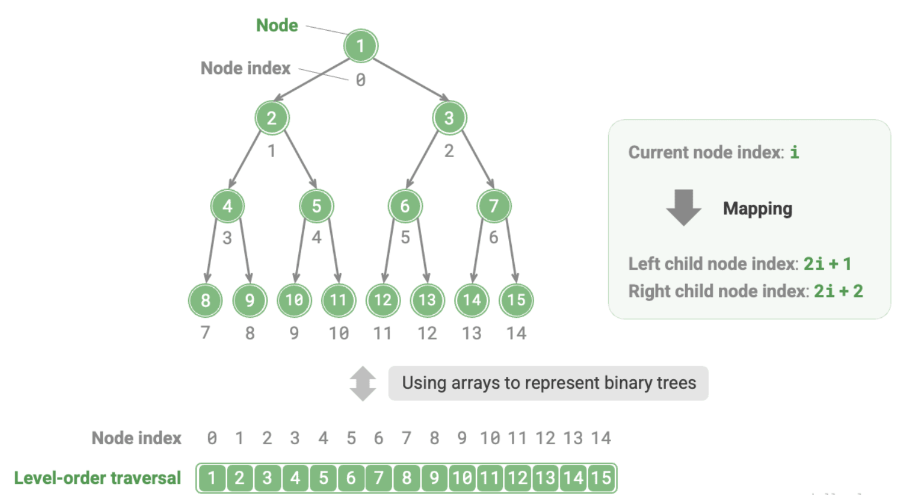
Array Representation of Binary Trees

Slide 13
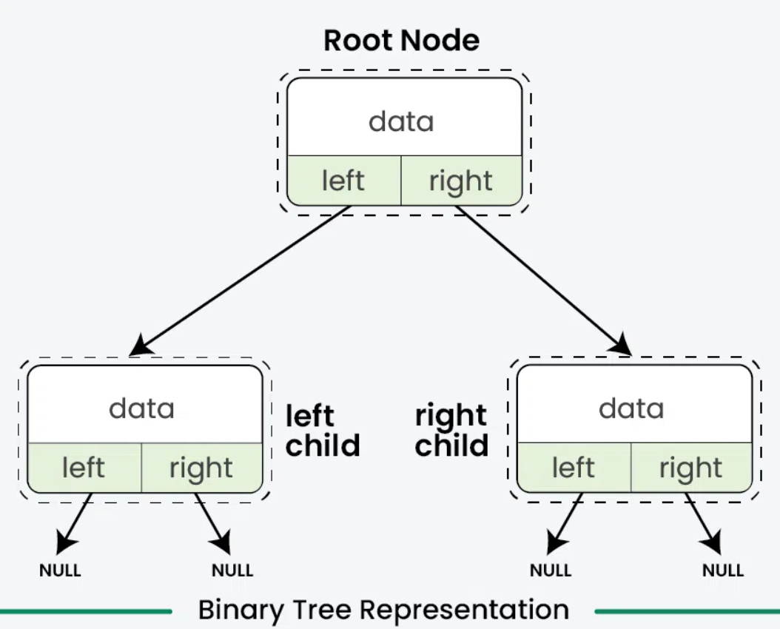
Linked Representation of Binary Trees

Slide 14
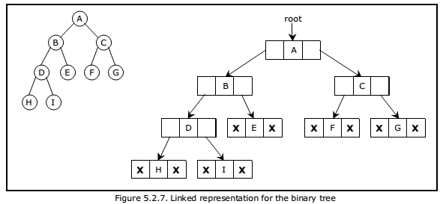
Linked Representation of Binary Trees

Slide 15
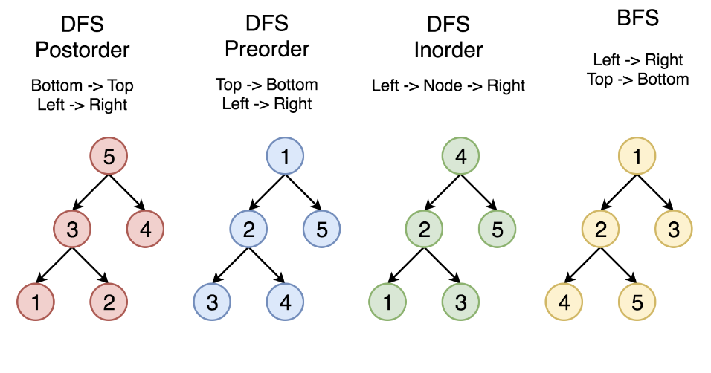
Traversing Binary Trees

Slide 16
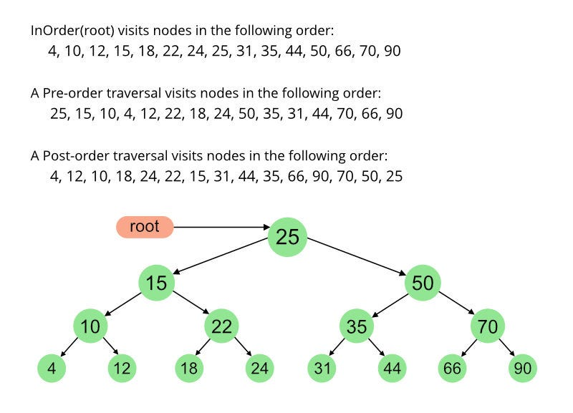
Traversing Binary Trees

Slide 17
Thanking you !!!!
Any question !!!!!
Download PPT : https://github.com/sachin365123/Applies-Data-Structure-and-Application-GLA-Online-Sessions-Jan---Jun-2026

